Slide 1
Preliminary Analysis of Minimum Wage in Dominican Republic

Slide 2
Research Question
What is the effect of minimum wage increases in the Dominican Republic?
Outcomes of interest
Inequality
Formal vs informal labor shares
Share of workers below min wage (non compliance measure)

Slide 3
Data Overview
ENCF household survey:
Longest continuous household survey with quarterly data 2014Q3-2025Q2
Rotating 5 quarter household panel with responses from individuals
Data on demographics/education, income sources, economic sector, worker/workplace characteristics.
Minimum Wage and CPI:
Quarterly data from 2014Q1- 2025Q2
Broken down by firm size/type of firm in real/nominal terms
Firm sizes based on employee count:
Micro: < 10
Small: 11-50
Medium: 51-150
Large > 150

Slide 4
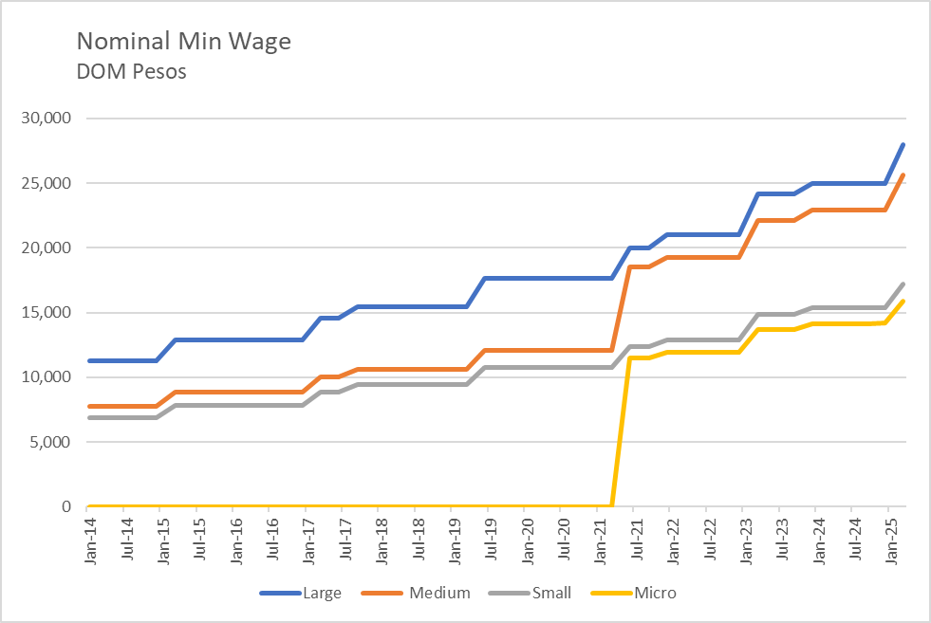
Minimum Wage Policy in Dominican Republic
Minimum wage is set at national level by committee every 2 years sometimes with a 2-quarter phase in.
Adjustment is based on inflation and other economic factors
Minimum wage is assigned to firms based on economic size
The growth rate of minimum wage is generally fixed for all firm sizes
Micro Firms were only introduced as a category in 2021Q3

Slide 5
Key Variables and Concepts From the Data
Primary Salary Income: Income reported by individual earned from salary in their primary job.
Formal/Informal: Individual asked if their company is registered with RNC
Firm Size: Individuals asked how many people work at their company. Used to match individuals with appropriate minimum wage.
Economic Sector: Indicator for the economic sector of a worker. Used to calculate exposure measure.
Inequality Measures: We calculate log 90/10 and 50/10 ratios to capture changes in inequality.
Below Min: Share of workers reporting below minimum wage salary. Used to assess non compliance.

Slide 6
Estimation Strategy Overview

Slide 7
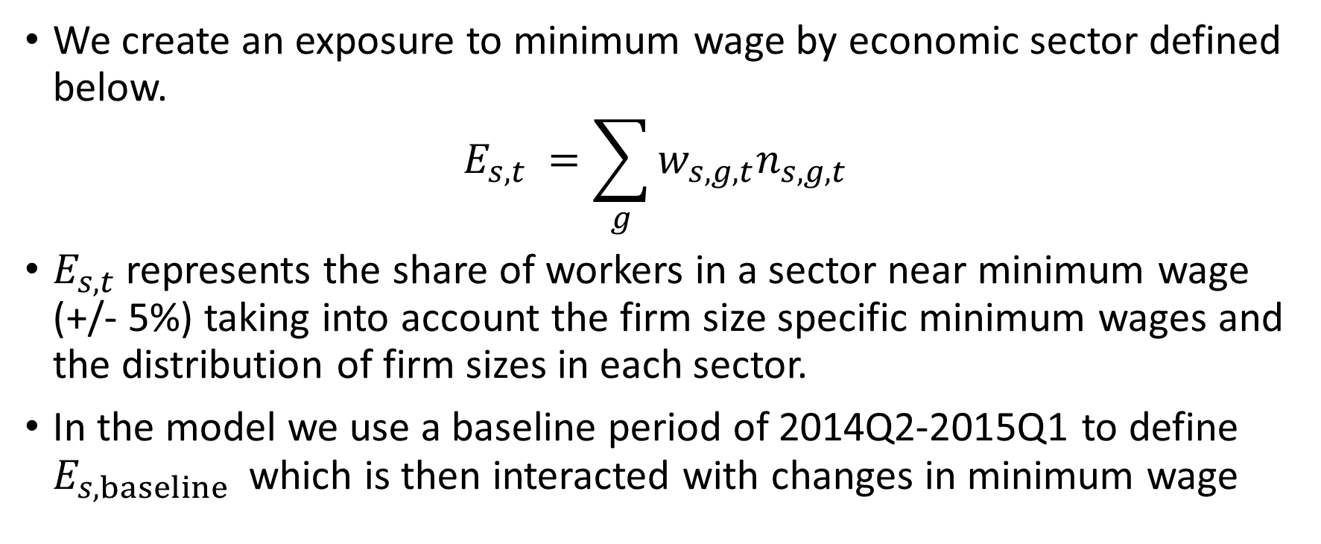
Defining Exposure to Minimum Wage For Economic Sectors
We create an exposure to minimum wage by economic sector defined below.
$$E_{s,t} =\sum_{g}{w_{s,g,t}n_{s,g,t}}$$
$E_{s,t}$represents the share of workers in a sector near minimum wage (+/- 5%) taking into account the firm size specific minimum wages and the distribution of firm sizes in each sector.
In the model we use a baseline period of 2014Q2-2015Q1 to define $E_{s, baseline}$ which is then interacted with changes in minimum wage

Slide 8
Treatment
Minimum wage jumps discreetly

Slide 9
Trends

Slide 10
Empirical Approach
Because there are multiple distinct increases to minimum wage in our dataset we seek to employ a stacked event study design taking into account each event.

Slide 11
Comparison to Previous work

Slide 12
Potential Data Issues

Slide 14
Empirical

